Slide 1


Optimizing a Blockchain Network
Payment Channels, Lightning Network, Cross-Chain, SegWit, Sidechains, Bitcoin-NG
Simeon Mandazhiev
Assistant Trainer
Academy School of Blockchain
http://kingsland.academy

Slide 2


Table of Contents
Solving the scalability and performance problems
Fast transactions, wide throughput
Scalable decentralized storage
Off-chain transactions and payment channels
Hashed Time-Locked Contracts (HTLC)
Lightning Network
Cross-chain transactions and atomic swaps
Sidechains and RSK

Slide 3
Table of Contents
Bitcoin-NG and the Waves Platform
SegWit and SegWit2X
IOTA and Tangle
EOS: a Super Scalable Smart Contract Platform
Casper: the Scalable Ethereum
Aethernity: Scalable Smart Contracts

Slide 4

Solving the Scalability and Performance Problems
Fast Transactions, Block Size, Scalable Storage

Slide 5


Bitcoin Scalability: Problems
Bandwidth
One megabyte per block
About 10 minutes per block
Removing this limit requires a “hard fork”
Changes are backward-incompatible
The high processing fees
The tendency of centralization
Larger requirements for storage, bandwidth, and computational power

Slide 6

Bitcoin Scalability: Current Limits
1 MB block
7 transactions per second @ 250 bytes/tx
~220 million transactions per year
Not enough for a city, let alone the world
Number of transactions per second (TPS) Bitcoin can handle:
TPS = block size limit / average transaction size / seconds between blocks
6.6 TPS = 1,000,000 / 250 / 600

Slide 7

Blockchain Scalability: Estimations
1 billion transactions per day
1.6 GB blocks (1655 MB)
87 terabytes/year (87029089 MB)
Maybe enough for a large metro area
7 billion people doing 2 blockchain transactions per day
24 GB blocks
3.5 TB / day
1.27 PB / year

Slide 8

Trends Toward Centralization
Bigger blocks == centralization
Very few full nodes
Very few miners
De facto inability to validate blockchain
Danger of 50% + 1 attacks
More than 50% of the hashpower is owned by just few entities
Solution: more individual miners
But Satoshi’s gentleman’s agreement about GPUs is clearly over: https://bitcointalk.org/index.php?topic=12.msg54#msg54

Slide 9

Growth Space Trend: Blockchain Size
Bitcoin full nodes must store the entire blockchain
Transaction validation requires entire history
The blockchain is about 150 GB in size (as of Jan 2018)
Downloading the blockchain peer-to-peer takes a few days

Slide 10
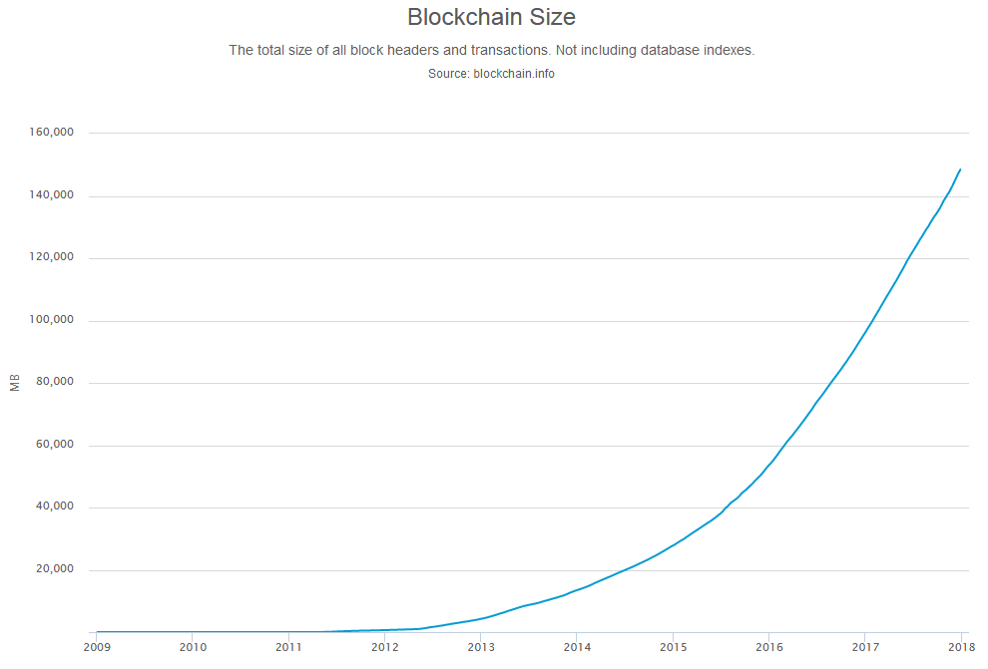
Exponential Growth Space Trend
A logarithmic data unveils
~ 1.8 x boost in the size of the blockchain every year
Growth space holds back many small participants
Thus increases centralization

Slide 11

Off-Chain Transactions
Payment Channels and Lighting Network

Slide 12

Off-Chain Transactions
Promising more speed and volume
Payments done directly with minimal fee
Independent
Separate from the main chain, limited damage on the chain
Offers more privacy (e.g. if use Zerocash)
Transactions not stored in the transaction history
Cannot be tracked anymore
Flexible: new innovations and design can be implemented

Slide 13
What are "Payment Channels"?
Payments channels, a.k.a. state channels
Allow two participants to send transactions to each other
Without hitting the main blockchain
Rely on a locked deposit to guarantee fair operations
Use multi-signatures
Do not require direct trust
Main chain
A
B

Slide 14
Payment Channels: Concepts
Two parties want to send off-chain payments
Deposit some money (e.g. in a smart contract) – on-chain
Sign and send many off-chain transactions
In case of dispute, the smart contract decides upon the signed proofs each party provides
Closing transaction: finalizes the balances – on-chain
Once created, payment channels can execute unlimited number of instant direct transactions

Slide 15
Hashed Time-Lock Contract (HTLC)
Hashed Time-Lock Contract (HTLC)
Off-chain payment protocol
Allows two parties to directly send funds using cryptography
HTLC combines two other concepts:
Hash-lock
To receive a payment, the recipient unlocks other's party payment
Time-lock
Locked funds are spent within certain time, or returned back

Slide 16
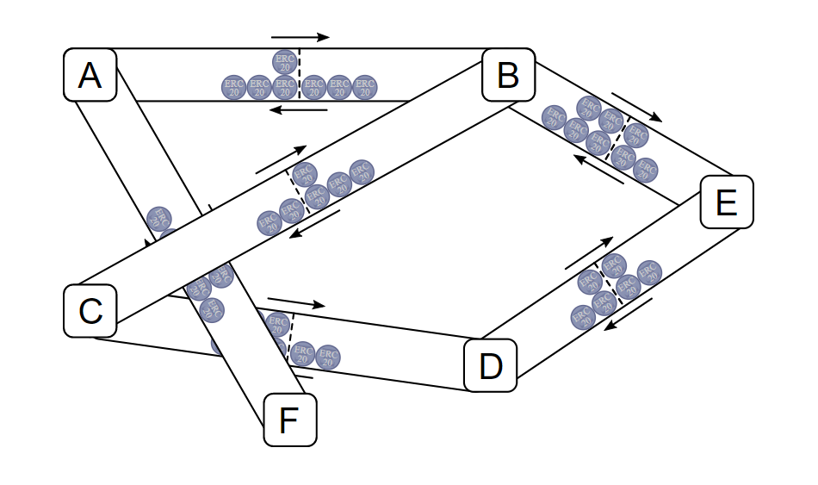
Payment Channel Networks: Concepts
Payment channels can connect each other in a graph
A payment channel network uses routing between channels
Inside the payment channel network all participants can transact off-chain, multi-hop, at almost no cost

Slide 17

Lightning Network
The lightning network is an off-chain micropayment system
Makes transactions work faster using payment channels
Conceptualized by Joseph Poon and Tadge Dryja
Aimed to solve the block size limit and the transaction delays
Lightning Network operates on top of Bitcoin
Often referred to as “Layer 2” network
Raiden Network operates on top of Ethereum
Similar concept, but for Ethereum

Slide 18

Key Storage
Keys are generated using BIP-32 HD wallets
Pre-generated by both parties
Generated in a Merkle tree, very deep within the tree
Each key can be a child of the previous key
For example, there can be many sub-keys for day 1
This key is used as a master key for all keys generated on day 1
By disclosing private keys pre-arranged, it is possible to invalidate millions of old transactions with only a few kilobytes of data
Core channels in the Lightning Network can conduct billions of transactions without a need for significant storage costs

Slide 19
Unidirectional Channel
Alice wants to send coins
Alice and Bob have MultiSig channel
First Alice gets a refund signed by Bob
Then sends 1 BTC to the MultiSig address
Even if Bob disappears, she can gets the coins back after 30 days when the time expires
Alice
1 BTC
Alice and Bob MultiSig Channel
1 BTC
Alice Refund Address
1 BTC
Signed by Bob
30-days nLlock Time

Slide 20
With no lock time Alice sends 0.1 BTC to Bob and 0.9 to herself
Transaction isn't signed by Bob yet
Then Alice sends 0.2 BTC to Bob and 0.8 to herself
Bob overrides the first transaction, but doesn't sign it
The channel over and Bob signs the transaction
If Bob doesn't sign Alice get her coins back when the time expired
Alice
0.8 BTC
No nLlock Time
Alice
0.9 BTC
Alice and Bob MiltiSig Channel
1 BTC
No nLlock Time
Alice
1 BTC
Signed by Alice
Bob
0.2 BTC
Signed by Alice
Bob
0.1 BTC
Alice Refund Addess
1 BTC
Signed by Bob
30-days nLlock Time

Slide 21
Bidirectional Channel
With 29 days lock time Alice sends 0.1 BTC to Bob and 0.9 to herself
The channel has two nLock times
Then Alice sends 0.2 BTC to Bob and 0.8 to herself
Bob wants to send 0.1 BTC to Alice so, get back the first transaction
Any time the transaction is get back, the time go close to the end day
When Alice and Bob both sign, the channel is closed
Alice
0.8 BTC
Alice
0.9 BTC
28-day nLlock Time
Alice
1 BTC
Alice and Bob MiltiSig Channel
1 BTC
Bob
0.1 BTC
Signed by Alice
Bob
0.2 BTC
Alice
0.9 BTC
29-day nLlock Time
Alice Refund Addess
1 BTC
Signed by Alice
Bob
0.1 BTC
Signed by Bob
30-days nLlock Time

Slide 22
3 Party Payments
Alice wants to pay Carol, they both have a channel open with Bob
Alice sends 0.01 BTC to Bob via off-chain transaction
Bob sends 0.01 BTC to Carol
Problem: Bob can keep the coins for himself, and Carol can clime she never got the coins
0.01 BTC
Bob
0.01 BTC
Existing channel
Existing channel
Alice
Carol

Slide 23
Hash-Locked Contracts
Using one-way hash functions, Alice can prove she sent funds to Carol off-chain
Pay to Contract
Knowledge of secret R hashed into hash H proves receipt
Receiver signs a contract stating if R is disclosed funds have been received
R
Hash function
H

Slide 24
Hash-Locked Contracts – Example
Carol chooses a random number R, and keeps it secret
She computes the hash of R, hash (R) = H
Carol sends H to Alice (secure, off-chain)
Alice sends 0.01 BTC to a new output: Bob & hash160(H)
To spend it, Bob needs to know R
Bob sends 1 BTC to Carol & H
Carol redeems Bob’s transfer, revealing R
Bob now knows R and can spend Alice’s transfer
The coins have gone from Alice to Carol via Bob
Carol`s signature and R
Bob
0.01 BTC & H
0.01 BTC & H
R
Hash function
H
Alice
Carol
H
H
R

Slide 25
Problems With Hash-Locked Contracts
If Carol refuses to disclose R, she will hold up the channel between Alice and Bob
If her channel expires after Alice and Bob’s she can steal funds by redeeming the hashlock
Bob has to be rich for this to really work
3rd party low-trust multisig and/or extremely small values sent can mostly work today
Bob
Carol`s signature and R
0.01 BTC & H
0.01 BTC & H
R
Hash function
Alice
Carol
H
H
H
R

Slide 26
Hashed Time-Lock Contract (HTLC)
If Bob can produce to Alice input R from hash H within 3 days, Alice will pay Bob 0.01 BTC
The above clause is void after 3 days
Either party may agree to settle terms using other methods if both agree
Violation of terms incurs a maximum penalty of funds in this contract
HTLC Output
0.01 BTC
0-nLockTime
requires R
3-day nLock time
Alice and Bob create new outputs and transactions from their channel (off-chain)
Bob
(Payment)
Alice
(Refund)
OP_DEPTH 3 OP_EQUAL OP_IF OP_HASH160 <R> OP_EQUALVERIFY OP_0 2
<AlicePubkey1> <BobPubkey1> 2 OP_CHECKMULTISIG OP_ELSE OP_0 2
<AlicePubkey2> <BobPubkey2> 2 OP_CHECKMULTISIG OP_END

Slide 27
Bitcoin Lightning Network (Part 1)
Alice wants to send funds to Dave via Bob and Carol
Dave sends Alice hash H produced from random data R
Alice & Bob create an HTLC output in the payment channel to pay Bob 0.01 BTC, with a 3-day nLockTime refund back to Alice
Bob & Carol create an HTLC output in the payment channel to pay Carol 0.01 BTC, with a 2-day nLockTime refund back to Bob
Carol & Dave create an HTLC output in the payment channel to pay Dave 0.01 BTC, with a 1-day nLockTime refund back to Carol
Dave can now get 0.01 BTC if he discloses R to Carol
HTLC 2-day nLockTime
Bob
Carol
HTLC 1-day nLockTime
HTLC 3-day nLockTime
H
H
R
Alice
Dave
Hash function
H
H
R
H

Slide 28
Bitcoin Lightning Network (Part 2)
Dave discloses R to Carol within 1 day
Carol now has enough information to pull funds from Bob
Carol and Dave agree to update the balances in the channel instead of broadcasting on the blockchain
Carol discloses R to Bob within 2 days
Bob now has enough information to pull funds from Alice
Bob and Carol agree to update the balances in the channel instead of broadcasting on the blockchain
Bob discloses R to Alice within 3 days
Alice can prove she sent funds to Dave
Alice and Bob agree to update the balances in the channel instead of broadcasting on the blockchain
0.01 BTC
HTLC 2-day nLockTime
Bob
Carol
HTLC 1-day nLockTime
0.01 BTC
0.01 BTC
HTLC 3-day nLockTime
H
R
H
R
Alice
Dave
R
H
H
R

Slide 29
Broken Chanel & Disputes
If Bob and Carol don’t cooperate, Carol immediately closes out the channel and broadcasts all pending transactions in the channel onto the blockchain
Carol redeems the 0.01 by disclosing the HTLC output and R on the Bitcoin blockchain
H
R
Blockchain
Bob observes R from the blockchain and can pull money from Alice off-chain
0.01 BTC
0.01 BTC
Bob
Carol
0.01 BTC
HTLC 3-day nLockTime
R
H
H
R
Alice
Dave
R
H
H
R

Slide 30
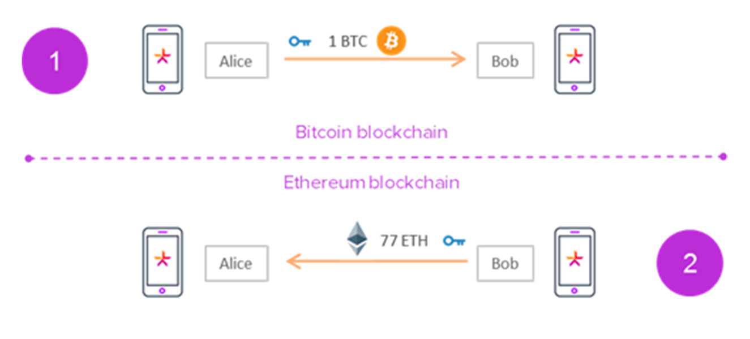
Connecting Blockchains
Cross-Chain Atomic Swaps

Slide 31
Connecting Blockchains
Cross-chain atomic swaps
Exchange funds between two participants, whose assets reside on separate blockchains (e.g. Bitcoin ↔ Litecoin)
Swapping cryptocurrencies without a trusted third-party
Execute a protocol that guarantees the atomicity of the transfer
The protocol should only have two outcomes, either participants successfully exchange assets, or nothing happens
Neither party can cheat the other

Slide 32
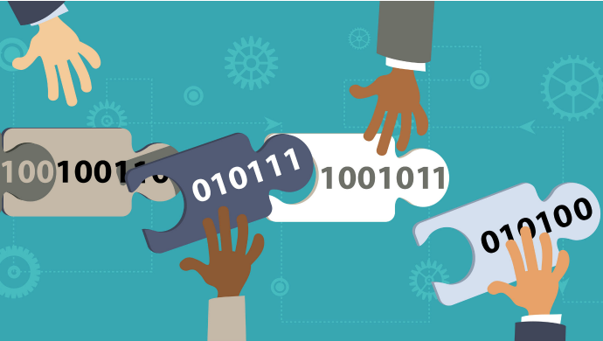
Cross-Chain Transactions with HTLC
Hashed Time-Lock Contract (HTLC) can work cross-chain
Payment channels open on both networks
Time-lock condition + hash-lock condition
Cross-chain atomic swaps using HTLC are already supported by the Lightning Network
Cross-chain trading allows to build decentralized exchanges
Example: crypto-bridge.org

Slide 33
Cross-Chain Transactions
Reveal same x value
2. Alice Refund TX SigAB
Cross-chain atomic swap
7. Bob Claim TX Reveal x SigAB
4. Bob Refund TX SigAB
6. Alice Claim TX Reveal x SigAB
48 hours
24 hours
3. Alice Commit TX Locked H(x) SigA
5. Bob Commit TX Locked H(x) SigB
Present x to claim
Alice Funding TX
Bob Funding TX
1. Generates random X

Slide 34
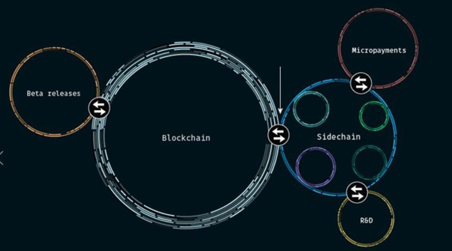
Sidechains
Parallel Blockchain Networks

Slide 35
What is "Sidechain"?
Sidechains are separate blockchains bound to Bitcoin’s chain
Allow to receive and spend bitcoins using a two-way peg (2WP)
2WP == lock coins on a network + unlock the same on the other
Sidechaining allows coins from one blockchain to be securely used within a completely separate blockchain
But still moved back to the original chain if necessary
The original chain is normally referred to as the "main chain"
Any additional blockchains are referred to as "sidechains"

Slide 36
Types of Sidechains
Federated sidechains
Don’t require any changes to the Bitcoin consensus rules
Example: The Elements Project (elementsproject.org)
Merge-mined sidechains
Use additional mining process + incentive system to implement additional functionality, e.g. smart contracts
Example: RSK (www.rsk.co)

Slide 37
Sidechain Internals
Symmetric 2WP
Consensus protocol to lock or unlock coins for cross-transfer
Suppose the secondary chain has “settlement finality”
The consensus is reached when a fixed number of parties (the consensus group) sign the block containing the cross­-chain transfer transaction
The mainchain takes signed block as the payload of a main chain transaction
Together with an SPV proof (Simplified Payment Verification)
The secondary chain consensus group unlocks the coins in the main chain

Slide 38
Sidechain
Bitcoin
Secondary blockchain
lock BTC tx mined
Confirmation period
Verification of SPV proofs (sidechain)
unlock secoins tx mined
reorg period
lock secoins tx mined
Confirmation period
Verification of SPV proofs (sidechain)
unlock BTC tx mined
reorg period
Affected blocks in secoins -> BTC transfer
Affected blocks in BTC -> secoins transfer

Slide 39

Sidechain Example: RSK
RSK is the first open source smart contract platform powered by the Bitcoin network
Also rewards the Bitcoin miners via merge-mining
Miners are paid for executing smart contracts
RSK adds functionality to the Bitcoin ecosystem
Smart-contracts
Instant payments
Higher-scalability

Slide 40
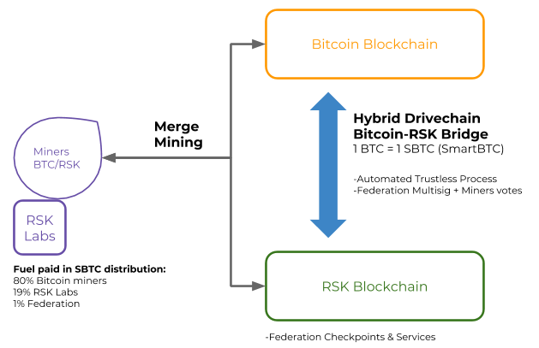
How RSK System Works?

Slide 41
Bitcoin-RSK Bridge (2 Way Peg Protocol)
Bitcoin
Secondary blockchain
lock BTC tx mined
Confirmation period
Verification of SPV proofs (sidechain)
unlock secoins tx mined
proposal
reorg period
Miners + Notaries votes (drivechain + multisig)
votes
lock secoins tx mined
unlock btc tx mined
Confirmation period
optional CLTV expiration period
Bridge proposes Bitcoin transaction
unlocked btc free
Notaries sign btc tx and broadcast
Affected blocks in secoins -> BTC transfer
Affected blocks in BTC -> secoins transfer

Slide 42

Bitcoin-NG
A Scalable Blockchain Protocol

Slide 43
Redesigning Blockchains for Scalability
Bitcoin-NG: next-generation blockchain protocol
Scalable blockchain protocol created by: Ittay Eyal, Adem Efe Gencer, Emin Gün Sirer, and Robbert van Renesse @ Cornell University
Implemented in the Waves Platform: https://waves-ng.wavesplatform.com
Uses multiple blocks per leader
Latency is limited only by the propagation delay of the network
Its bandwidth is limited only by the processing capacity of the individual nodes

Slide 44
Redesigning Blockchains for Scalability
The Bitcoin blockchain model
Old block
New block
T
B
Leader node
Ordinary node
T
T
T
T
Transaction validation
B
Block extension
b
Block extension (proposed)

Slide 45
Redesigning Blockchains for Scalability
Bitcoin-NG: multiple blocks per leader
Bitcoin-NG uses two steps:
Leader election
Transaction serialization
It divides time into epochs
In each epoch, a single leader serializes the state machine transitions
To facilitate state propagation, leaders generate blocks
T
B
T
B
1
T
T
T
n

Slide 46
Bitcoin-NG
Two types of blocks:
Key blocks and microblocks
The interval between consecutive key blocks is exponentially distributed
To maintain a set average rate, the difficulty is adjusted by deterministically changing the target value based on the Unix time in the key block headers
In case of a fork, just as in Bitcoin, the nodes pick the branch with the most work, aggregated over all key blocks, with random tie breaking

Slide 47
Bitcoin-NG
Key block contains
The reference to the previous block (either a key block or a microblock, usually the latter)
The current Unix time
A coinbase transaction to pay out the reward
A target value, and a nonce field containing arbitrary bits
For a key block to be valid, the cryptographic hash of its header must be smaller than the target value
Unlike Bitcoin, a key block contains a public key that will be used in subsequent microblocks
To generate a key block, the miner must iterate through nonce values until the cryptopuzzle condition is met

Slide 48
Bitcoin-NG
A microblock contains ledger entries and a header
The header contains the reference to the previous block
The current Unix time
A cryptographic hash of its ledger entries
And a cryptographic signature of the header
The signature uses the private key that matches the public key in the latest key block in the chain
For a microblock to be valid, all its entries must be valid according to the specification of the state machine, and the signature has to be valid

Slide 49
Bitcoin-NG
Once a node generates a key block it becomes the leader
As a leader, the node is allowed to generate microblocks at a set rate smaller than a predefined maximum
The maximum rate is deterministic, and can be much higher than the average interval between key blocks
The size of microblocks is bounded by a predefined maximum
Specifically, if the timestamp of a microblock is in the future, or if its difference with its predecessor’s timestamp is smaller than the minimum, then the microblock is invalid
This bound prohibits a leader (malicious, greedy, or broken) from swamping the system with microblocks

Slide 50
Structure of the Bitcoin-NG Chain
Microblocks (circles) are signed with the private key
Matching the public key in the last key block (squares)
Fee is distributed
40% to the leader and
60% to the next one- Generation Blockchains protocol
40%
60%
fees
PK_{A}
sig_{A}
sig_{A}
sig_{A}
PK_{B}
sig_{B}
New microblock is generated every 10 seconds
New key block appears every 10 minutes
10 seconds
10 minutes

Slide 51
Bitcoin-NG
Microblocks do not affect the weight of the chain, as they do not contain proof of work
This is critical for keeping the incentives aligned
If microblocks carried weight, an attacker could keep secret microblocks and gain advantage by mining on microblocks unpublished to anyone else
To maintain a set average rate, the difficulty is adjusted by deterministically changing the target value based on the Unix time in the key block headers
In case of a fork, just as in Bitcoin, the nodes pick the branch with the most work, aggregated over all key blocks, with random tie breaking

Slide 52
Bitcoin-NG
Key block fork
Blocks have the same chain weight
And the fork is not resolved
Until key block “7” is published
2^{l}
3^{l}
4^{l}
5^{l}
6^{l}
7^{l}
8^{l}
1
2
3
4
5
6
7

Slide 53
Bitcoin-NG
Forks are resolved by extending the longest branch aggregated over all keyblocks
Microblocks do not contribute to the length of a branch since these do not contain proof-of-work
To penalize a leader that creates forks in the generated microblocks, a subsequent leader can insert a special poison transaction
This invalidates the malicious leader’s reward, a fraction of which is paid to the reporting leader
Forks can also occur when a new leader has been elected but the previous leader has not yet heard about it and continues to generate microblocks
However, such forks are resolved as soon as the announcement of the new leader election reaches all the nodes

Slide 54
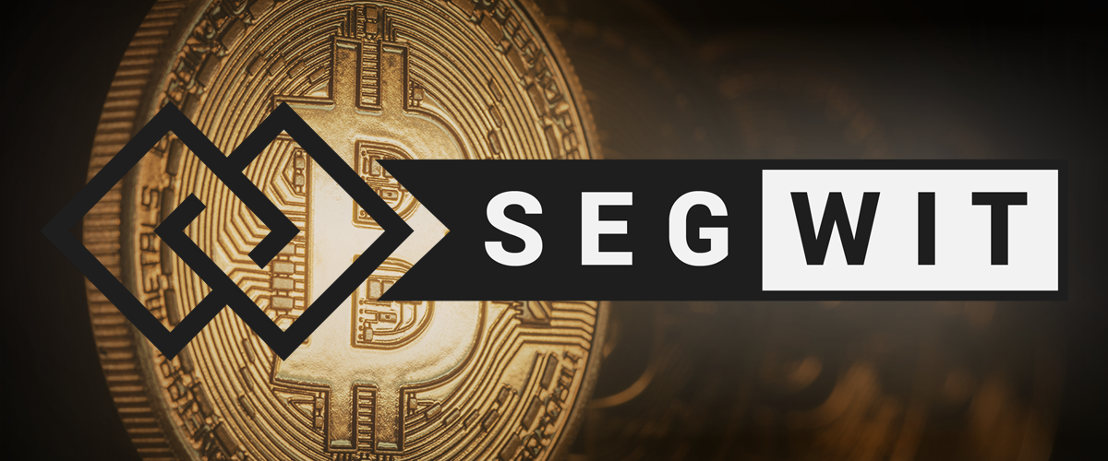
SegWit (Segregated Witness)
A Bitcoin Protocol Improvement

Slide 55

SegWit
Segregated Witness == SegWit
Segregate means to separate
Witnesses are the transaction signatures
Implemented soft fork in the Bitcoin-based networks
SegWit improves the scalability of the Bitcoin network
Separated transaction signatures → more transactions in a block
Implemented by currencies such as Litecoin, Bitcoin Gold, etc.

Slide 56
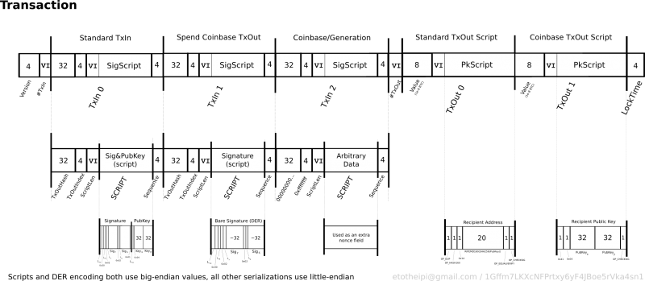
What is a Bitcoin Transaction?
Source: https://en.bitcoin.it/wiki/File:TxBinaryMap.png

Slide 57
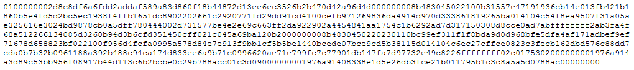
What is Bitcoin Transaction?
Raw transaction in HEX format:

Slide 58
SegWit
SegWit is splitting the transaction into two segments
Removing the unlocking signature ("witness" data) from the original portion
And appending it as a separate structure at the end
Block header
Inputs
Outputs
TXID Signatures
Signatures
Amount Script
Tampering
Signatures
TXID Signatures
Amount Script
Merkle tree of txn and witness

Slide 59
SegWit
The original section would continue to hold the sender and receiver data
And the new "witness" structure would contain scripts and signatures
The original data segment would be counted normally, but the "witness" segment would, in effect, be counted as a quarter of its real size
Block header
Tampering
Merkle tree of txn and witness

Slide 60
Advantages of SegWit
Drop signatures from relay
Prune old signatures
Solves all unintentional malleability
Block header
Tampering
Merkle tree of txn and witness

Slide 61
Transaction Malleability
The signature that goes along with the input data can be manipulated
Which in turn can change the transaction ID
It can make it seem like the transaction didn’t even happen in the first place
Inputs
Outputs
TXID Signatures
TXID Signatures
TXID Signatures
Amount Script
TXID Signatures
Amount Script

Slide 62
Script Versions
Instead of pushing the redeem script directly, add a version byte
Witness protected program
Unknown version → anyone can spend
No longer restricted to redefining OP_NOP opcodes
All future Script changes become soft forks
Schnorr signatures, mast, value under signature
Inputs
Outputs
Inputs
Outputs
Witness
{v. “Script”}
Amount Script
Signature
Amount Script

Slide 63
Script Versions
Two versions defined immediately:
v0 with the (small) redeem script in output
v1 with the (larger) redeem script in witness
Makes marginal non-witness size of out/in O(1)
Inputs
Outputs
Inputs
Outputs
Witness
{v. “Script”}
Amount Script
Signature
Amount Script

Slide 64
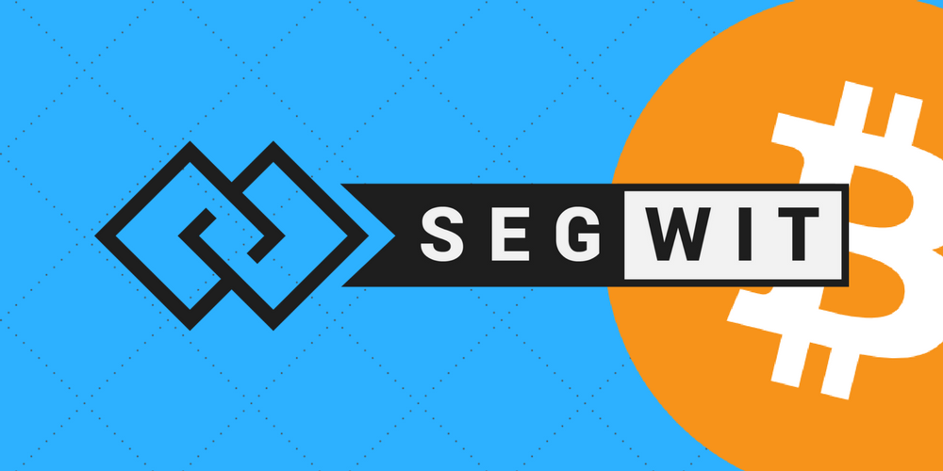
SegWit Activation
SegWit was activated on August 24, 2017
Nonetheless, most Bitcoin network transactions have not begun to use the upgrade
In the first week of October 2017, the proportion of network transactions using SegWit was 10%

Slide 65

SegWit2X
SegWit2x == SegWit + 2MB blocks hard fork
Increase the block size and improve Bitcoin scalability
SegWit2x uses a different 'bit' for signaling (bit 4 instead of bit 1) than SegWit
SegWit2x didnt't get enough support and was canceled by his creators on 8 November 2017

Slide 66

IOTA
Tangle-Based Transaction Storage

Slide 67
IOTA
IOTA uses "tangle" to keep transactions instead of blockchain
The tangle is directed-acyclic graph, not a chain (list)
No blocks, transactions are immediately attached to the tangle
Each new transaction requires to verify two previous
The IOTA consensus algorithm confirms transactions efficiently and prevents double-spending
IOTA is not yet completely decentralized, has 34% attack

Slide 68

EOS
New Blockchain Architecture

Slide 69
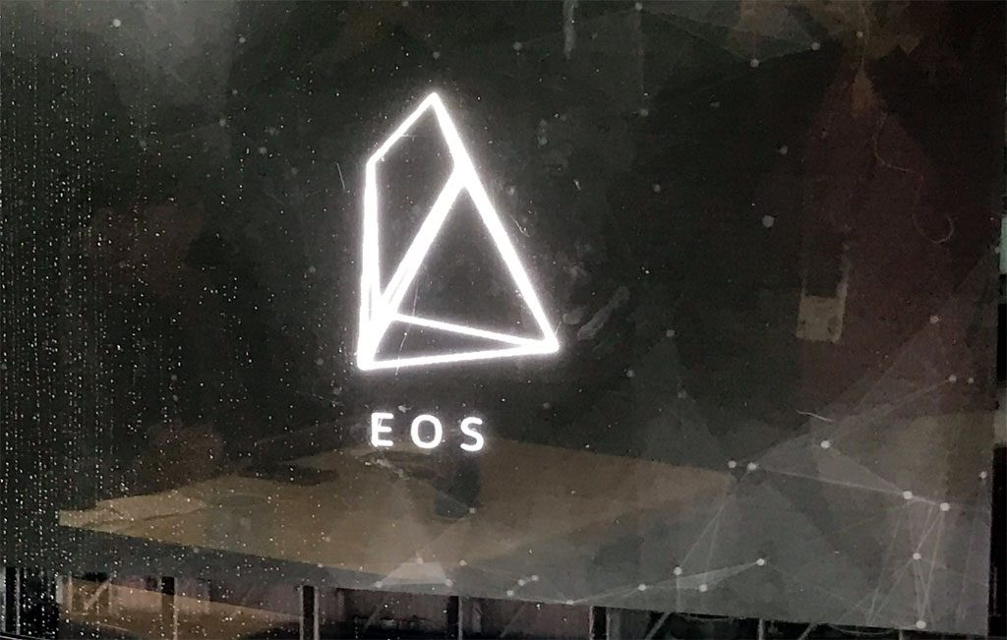
EOS
EOS == blockchain architecture designed to enable vertical and horizontal scaling of decentralized applications
Powerful decentralized platform for smart contracts
The EOS network provides:
Accounts & authentication
Databases (JSON collections)
Asynchronous messaging
Scheduling of applications across multiple CPU cores and/or clusters

Slide 70
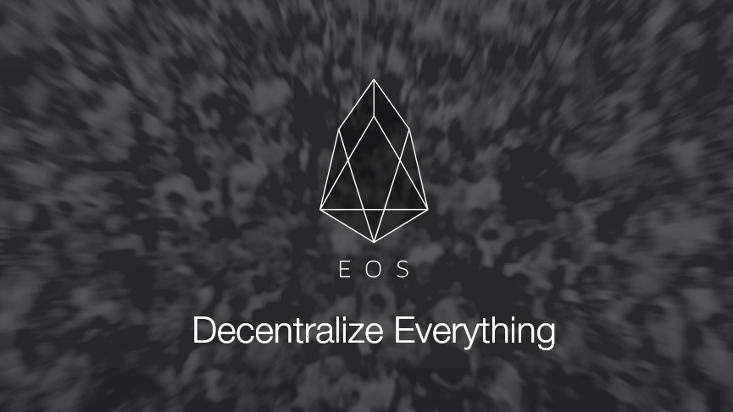
EOS
The resulting technology is a blockchain architecture that has the potential
To scale to millions of transactions per second
Eliminates user fees
Allows for quick and easy deployment of decentralized applications
Testnet launched in Sept / 2017
Mainnet expected in June / 2018

Slide 71
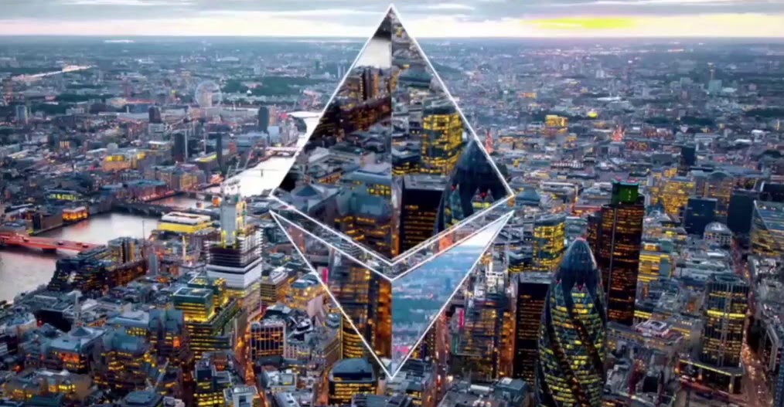
Casper
Ethereum 2

Slide 72
Casper: Transition to Proof-of-Stake
Based on Proof-of-Stake (or similar) rather than Proof-of-Work
Mining will become redundant
The network post-Casper will rely on stakers and staking pools
Stakers will be rewarded for their service to the network
Less resources will be wasted
Still attacks will be very expensive
Expected to reduce the inflation rate to between 0.5% to 2%

Slide 73
Casper: Sharding
Currently all Ethereum nodes process all transactions
A lot of resources are wasted
30 000 nodes do the same duplicated work
Sharding will allow parallel transactions, e.g.
A set of 100 nodes process 1000 txs
In the same time, other 100 nodes process other 1000 txs
Finally the results are merged into a single result
Conflicting transactions are handled properly

Slide 74

Aeternity
Scalable Smart Contracts

Slide 75
Aeternity
Virtual machine for smart contracts + Chalang language
State channels for payments + smart contracts
Scalable as long as there is no disagreement between the counterparties
Token called an "æon" or "AE token“
Used to pay for space and computation time on the virtual machine

Slide 76

Summary
Blockchain networks have scalability and performance problems
Payment channels allow unlimited free direct transactions
Implemented by Hashed Time-Locked Contracts (HTLC)
Payment channel networks like "Lightning network" implement
Off-chain and cross-chain transactions
Sidechains (like RSK) attach a blockchain to existing one to provide more functionalities
New architectures (like Bitcoin-NG and EOS) promise to solve the performance limitations

Slide 77
Optimizing a Blockchain Network
http://www.kingsland.academy

Slide 78
Resources
Payment channels explained: https://arxiv.org/pdf/1702.05812.pdf
Scalabilaty: https://www.oreilly.com/ideas/blockchain-scalability
SegWit: https://segwit.org, https://en.wikipedia.org/wiki/SegWit, https://blockgeeks.com/guides/what-is-segwit/, https://en.bitcoin.it/wiki/Transaction
Lighting Network: https://lightning.network/
Off-chain transactions: https://blog.lightning.engineering/announcement/2017/11/16/ln-swap.html
Bitcoin NG: https://www.usenix.org/system/files/conference/nsdi16/nsdi16-paper-eyal.pdf
IOTA: https://blog.iota.org/
EOS: https://eos.io/
Aeternity: https://blog.aeternity.com/

